Slide 1

DEEP LEARNING FINAL PROJECT
Automatic Image Caption Generator
Submitted to Professor Maria Vakalopoulou
Prepared by Prannoy Noel Bhumana and Shahmir Kazi
Masters in Data Sciences and Business Analytics

Slide 2
1
MOTIVATION AND PROBLEM DEFINITION
2
BUILDING REQUIRED VOCABULARY AND RESIZING IMAGES
3
DEFINING DATA LOADER AND
CREATING CNN & RNN
4
TRAINING, TESTING, EVALUATION,
REFERENCES AND CONCLUSION

Slide 3
MOTIVATION AND
PROBLEM DEFINITION
1

Slide 4
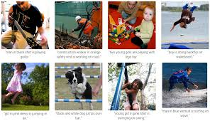
Introduction
1.1
Problem Definition
Given
Unlabeled images,
Use
Deep Learning and Natural Language Processing Techniques (CNN. RNN< Sentence Generation)
To
Accurate automatic image captioning
The output would be a text derived from the single 2D image.
Motivation
It is widely used in the field of ecommerce for accurately tagging and captioning product catalogues and images.
In social media it is prevalent for understanding user behavior in real time and may be used for real time ad targeting and monetization.
Its impact on the visually impaired is also of high magnitude, allowing understanding which was previously not possible. Allows allows image description to be heard making content more accessible
Furthermore, it can also be applied to niche subject areas such as medicine, where it may be used as a guide to human judgement.
SUBJECT PRESENTATION

Slide 5
Introduction
1.1
Methodology
Images are represented as a 2D matrix, using CNN (Convolutional Neural Networks).
A LSTM (Long Short Term Memory) is a kind of RNN (Recurrent Neural Network) that performs better than a standard RNN.
Our model may be referred to as a CNN_RNN model as the features will be generated through CNN, upon which RNN/LSTM will generate the descriptions (captions).
Usually, a pretrained CNN extracts the features from our input image.
The feature vector is linearly transformed to have the same dimension as the input dimension of the RNN/LSTM network.
Then the network is trained as a language model on our feature vector.
For training our LSTM model, we predefine our label and target text

Slide 6
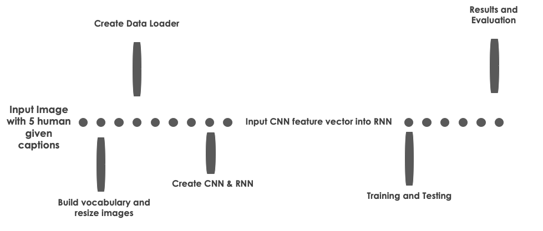
Introduction
1.1
Methodology

Slide 7
BUILDING REQUIRED VOCABULARY AND RESIZING IMAGES
2

Slide 8
BUILDING REQUIRED VOCABULARY
2.1
Functions
Explanation
class Vocabulary(object):
def __init__(self):
def add_word(self, word):
def __call__(self, word)
def __len__(self)
def build_vocab(json)
DICTIONARY
Iterate through all training captions
Create dictionary of unique words, where every words has corresponding integer
Add special tokens
EMBEDDING LAYER
To transforms each word in a caption into a vector of a desired consistent shape
NUMERICAL REPRESENTATION
Need input ready for LSTM
For calculating loss functions and optimizers
Turn a sequence of words into a sequence of numerical values, i.e - a vector of numbers where each number maps to a specific word in our vocabulary
Libraries
import nltk,pickle
import argparse
from collections import Counter
from pycocotools.coco import COCO

Slide 9
RESIZING IMAGES
2.2
Functions
def resize_image(image, size)
def resize_images(image_dir, output_dir, size)
Explanation
While loading the dataset, it is important to have uniformity over the dataset, to prepare the data for input into our model.
Simultaneously, size of the images must also be taken into account
Resize the images in input_dir to output_dir through image_size = [256,256]
Libraries
import nltk,pickle
import argparse
from collections import Counter
from pycocotools.coco import COCO

Slide 10
DEFINING DATA LOADER AND
CREATING CNN & RNN
3

Slide 11
DEFINING DATA LOADER
3.1
Functions
class CocoDataset(data.Dataset):
def __init__(self, root, json, vocab):
def __getitem__(self, index)
def __len__(self)
def collate_fn(data):
def get_loader
Explanation
Created custom dataset with preprocessing on each caption.
Create Collate function to create tuple of image, label and length of caption
This dataset is fed into data loader with a batch size of 128 and collated data is loaded.
Data Loader will return (images, captions, lengths) for each iteration:
images: a tensor of shape (batch_size, 3, 224, 224).
captions: a tensor of shape (batch_size, padded_length).
lengths: a list indicating valid length for each caption.
length = batch_size
Libraries
import torch
import torchvision.transforms as transforms
import torch.utils.data as data
import os
import pickle
import numpy as np
import nltk
from PIL import Image
from pycocotools.coco import COCO

Slide 12
CREATING CNN
3.2
Explanation
Functions
class EncoderCNN(nn.Module):
def __init__(self, embed_size):
def forward(self, images):
PROCESS
→ Extract Image Feature map though CNN
++ we require Position Information - map words to objects through an extracting features from lower level of CNN
→ Pass them through RNN
→ Pass through Softmax to get scores of each word
CNN
A convolutional neural network can be used to create a dense feature vector
This embedding becomes a dense representation of the image and will be used as the initial state of the LSTM.
We use pre trained Res-Net 152 in the encoder.
8x deeper than VGG bhut lower complexity
We pass the image through a modified densely connected neural network to obtain a 1024-dimensional output vector
Transform with Normalization
Load vocabulary wrapper and Build Data Loader
Libraries
import torchvision.models as models
from torch.nn.utils.rnn import pack_padded_sequence
import torch.nn as nn

Slide 13
CREATING RNN
3.3
Functions
Explanation
class DecoderRNN(nn.Module):
def __init__
def forward(self, features, captions, lengths)
def sample(self, features, states=None):
RNN - chose LSTM instead of GRU through research [3] [6]
LSTM useful for lengthy sequence of words
LSTM cell works as follows:
Has input for data point at t=n
Has input for previous cell state
Has input for previous hidden state
Has output for the current cell state
Has output for the current hidden state
LSTM Data Output = LSTM Hidden State output
At each step, we use same LSTM;
Goal of the cell under optimization is to find the right set of weights to accommodate whole dictionary
Hence for each word in sentence (sequence)
→ Input = Word
→ Output = Probability distribution over whole dictionary
Hence obtain best fit in sequence given the previous word
Libraries
import torchvision.models as models
from torch.nn.utils.rnn import pack_padded_sequence
import torch.nn as nn

Slide 14
TRAINING, TESTING, EVALUATION, REFERENCES AND CONCLUSION
4

Slide 15
TRAINING
4.1
Explanation
Parameters
CNN output feature vector = LSTM input
LSTM cell requires same shape of vector at each step
LSTM input = individual words of training caption
RNN used for:
Remembering spatial information from input feature vector
Predict the next word
First word = Start token
Next word = That in the training caption
At each step:
Input = Current caption word
Output = Input + Hidden state of LSTM cell
Output passed to fully connected layer
To produce distribution for next word
Hence we reach End token
The recurrence function updates weights through back propagation until LSTM cells product correct words
Batch sizing also used for training image-caption pairs
embed_size = 256
hidden_size = 512
num_layers = 1
learning_rate = 0.001
num_epochs = 1
log_step = 10
encoder = EncoderCNN(embed_size).to(device)
decoder = DecoderRNN(embed_size, hidden_size, len(vocab), num_layers).to(device)
criterion = nn.CrossEntropyLoss()
params = list(decoder.parameters()) + list(encoder.linear.parameters()) + list(encoder.bn.parameters())
optimizer = torch.optim.Adam(params, lr=learning_rate)

Slide 16
TESTING AND EVALUATION
4.2
Functions
def test_image(in_image):
encoder = EncoderCNN(256).eval() # eval mode (batchnorm uses moving mean/variance)
decoder = DecoderRNN(256, 512, len(vocab), 1)
Generate a caption from the image
Convert word_ids to words
RESULTS
Tested on random images from internet.
The model performed very well most of the images.
At some instances, it is not able to capture the all the objects in the image.

Slide 17
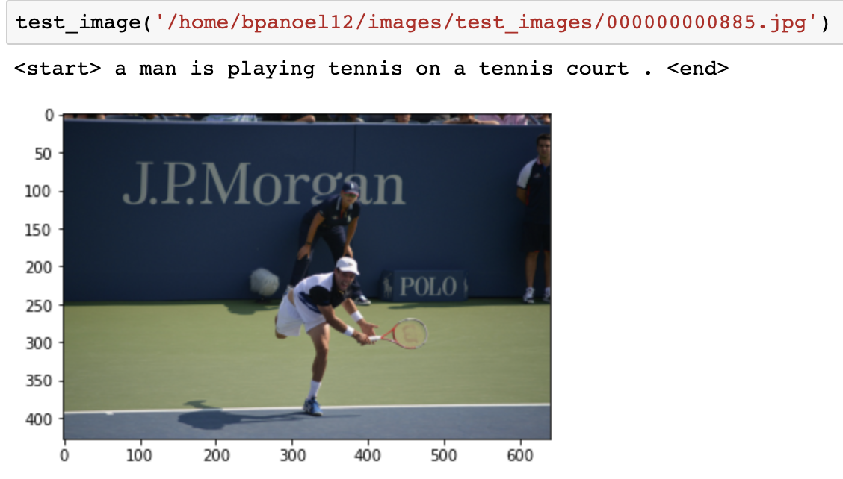
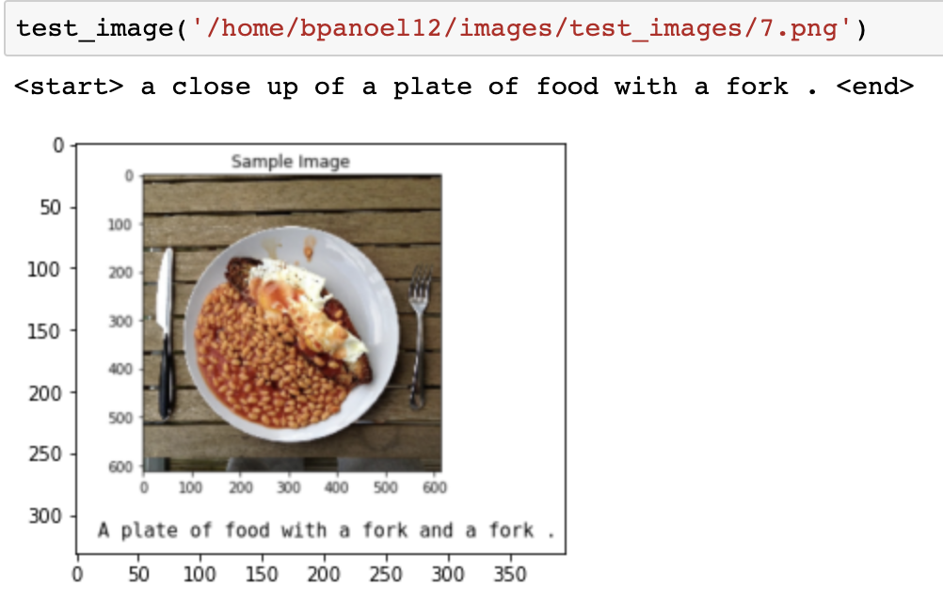
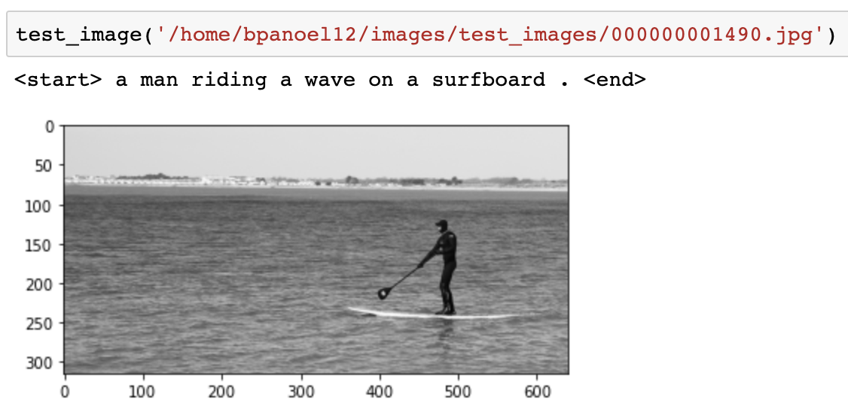
TESTING AND EVALUATION
4.2

Slide 18
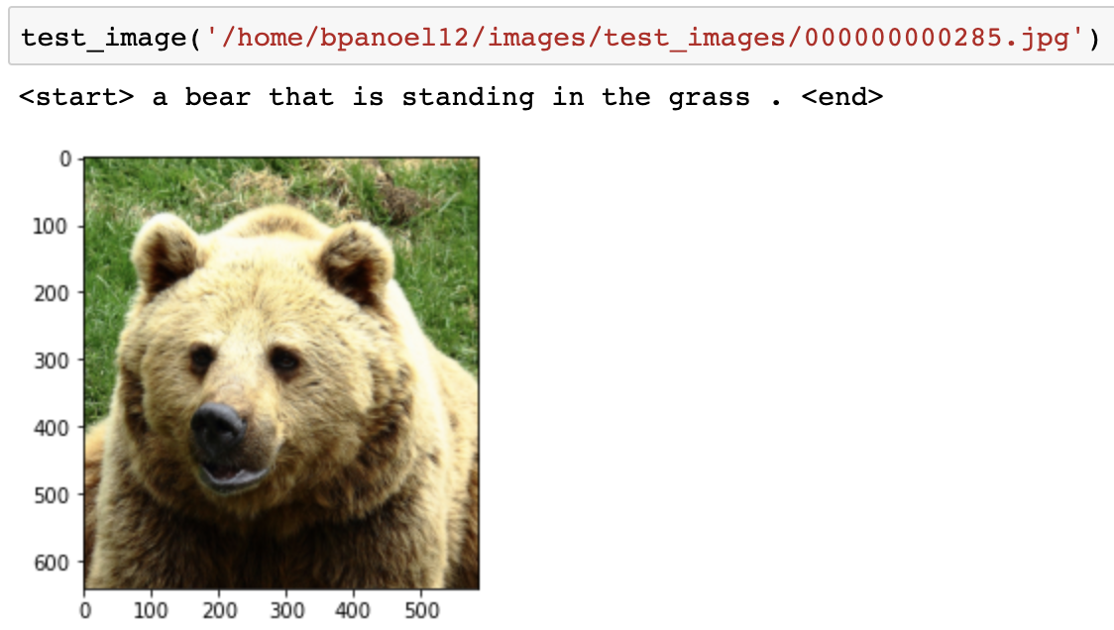
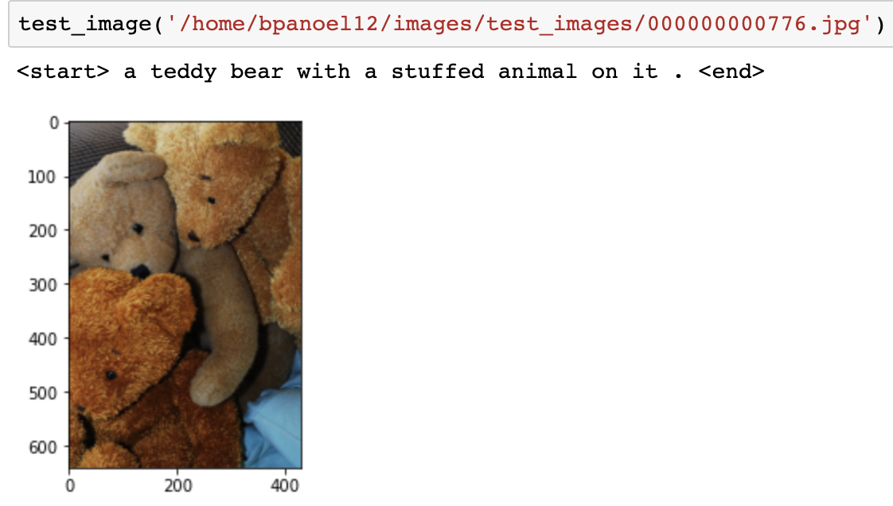
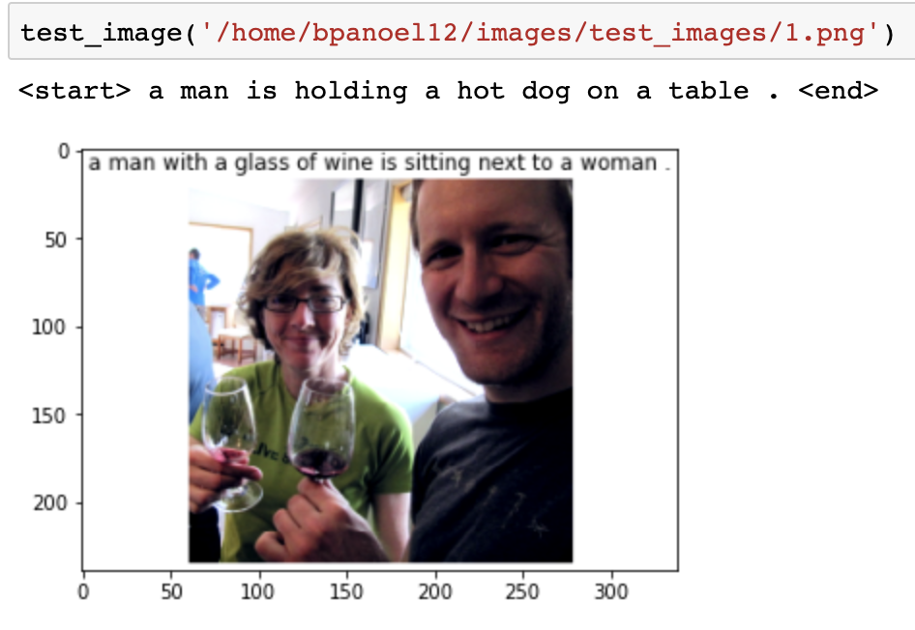
TESTING AND EVALUATION
4.2

Slide 19
CONCLUSION
4.1
Challenges faced
Training the data due to RAM and GPU limitation.
Scalability
BLEU-4 score implementation
Future scope of improvement
Train on whole dataset.
Use GRU inplace of LSTM which may or maynot result in better results.
Evaluate the model based on BLEU-4 score
CONCLUSION

Slide 20
THANK YOU

